Slide 1
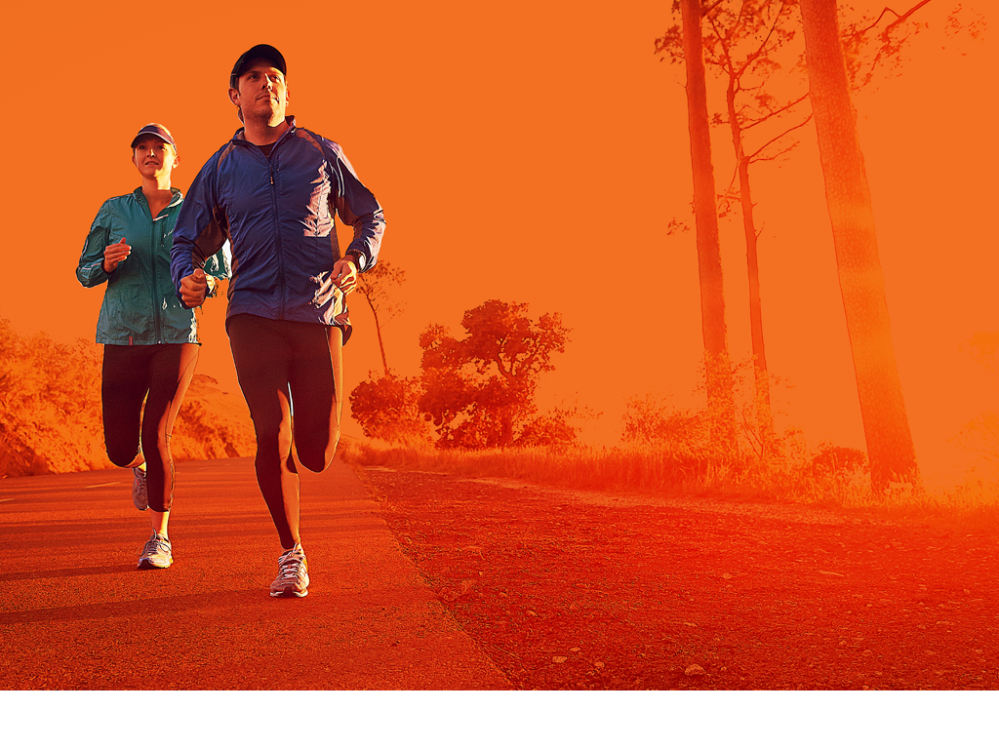
INSPIRATION
for MOVE AGENTS

Slide 2
INSPIRATION
Campaign Promotion
Jennifer Griffin
Email Website Facebook
YouTube
MOVE Minute – Scotland
Organised by: South Lanarkshire Leisure and Culture
Budget: € 0 – € 100
Participants: 15.000
WHAT
Easy and affordable local concept that anyone can use to promote sport and physical activity to children.
MOVE Minute was created by SLLC's active schools coordinators who visit schools together with their Youth Sport Trust Young Ambassadors and encourage pupils and staff to take part in one minute of physical activity to show how easy it is to move every day. Schools then sign a pledge, which means that they agree to 'move more' as a whole school.
The objectives of “MOVE Minute” are:
To communicate that being physical active is a simple but long term process which can be easily integrated in everyone’s daily schedule
To offer all children and young people the motivation and opportunities to 'get active’
HOW
Visiting schools during MOVE Week. Involving young ambassadors.
OUTCOME
Simple but long term process which is easy and fun for everyone. Active celebration of movement.
Tip from one MOVE Agent to another:
Coordination between the schools and MOVE Minute volunteers was key in order to cover as many schools as possible and get the message across. This is a great opportunity to promote other MOVE Week events or activity sessions.

Slide 3
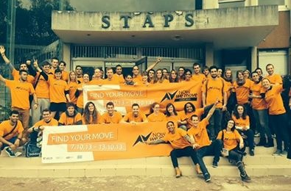
INSPIRATION
Planning and Coordination
Contact
Email Website Facebook YouTube
Report
Viens partager ton energié - France
Organised by: Students of the University Paris Sud / Association of Students in Sport Management d'Orsay
Participants: 3.150 participant s/ 65 volunteers
WHAT
Week-long event including conference and wide range of physical activities.
HOW
Pre-planned and coordinated by students from the University of Paris Sud / AEMSO
OUTCOME
Debate on the potential of edutainment through sport in regard European identity and citizenship.
"Viens partager ton energié” is a sporting event that invites citizens and all public to do a wide range of physical activities and participate in a conference on Europe, Sport and Citizenship, with expert input from specialists in these fields.
The conference is called: "Edutainment Entertainment in and through sport: a key to promote a constructive dialogue between European citizens”.
The objectives of "Viens partager ton energié" are:
To develop the students’ and the general public’s awareness of the importance of regular physical activity for health
To use sport and physical activity to educate students and the general public about the capabilities and qualities of people with disabilities

Slide 4
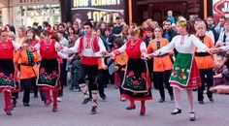
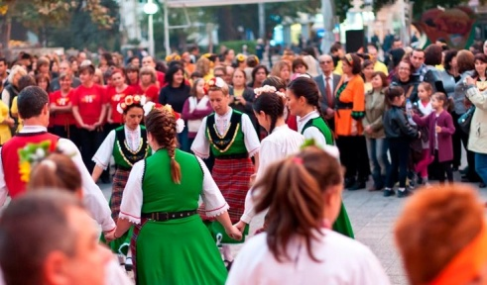
INSPIRATION
Flagship city event
Laska Nenova
Email Pinterest
Now We Dance - Bulgaria
Organised by: WOW Sport, Eva Sport and 24 dance clubs, Plovdiv
Budget: € 250
Participants: 600 dancers, more than 2.000 participants
WHAT
Flagship city event. Activity that involves as many by-standers and passers by as possible.
HOW
Use an activity that is popular and easy to participate in a public space. Dance schools from the city promote the event is a fun way to activate the city.
Now We Dance featured Bulgarian national dances (horo), which are one of the very popular forms of aerobics.
Plovdiv Municipality allowed us organise the event in the very center of the city in front of the Municipality Building. We were working together with 24 dance clubs - some of them came with more than 100 dancers. We had dancers ofall ages. The National BNT 2 TV broadcast live coverage of the event.
The main message was "Lets do something together for the city and for the people and have fun".
Planning: We had the idea in early spring. The first meeting between the two main partners happened in August and then in September and October we started approaching dance clubs. Within a month most of them agreed to join in. Some came just two days before the event.
Objective: To motivate people to participate in the event, not just stand and watch. Traditional Bulgarian dances are something that no Bulgarian can resist to take part in.
OUTCOME
600 dancers, 2.000 participants, 3 main organisers. Sponsor provides water.
Tip from one MOVE Agent to another:
Believe in partnerships. Think out of the box and find your common goal.

Slide 5
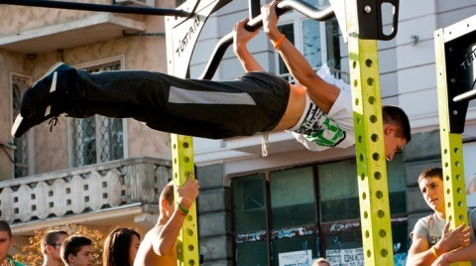
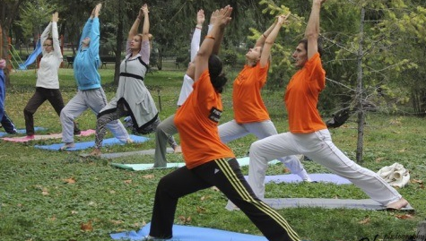
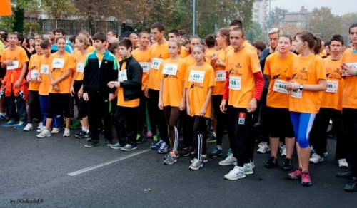
INSPIRATION
Partnership for National coordination of MOVE Week
NowWeMove Bulgaria – We coordinate in partnership
Laska Nenova
Email Pinterest
WHAT
Informal partnership agreement between 3 organisations from different sectors – BG Be Active, Plovdiv (formerly known as WOW Sport), FunCity (Varna) and Bulsport (Sofia) to implement and organise MOVE Week activities across Bulgaria. We knew that if we joined forces we could achieve much more than working on our own.
HOW
The partnership was based on good will, trust and a common goal to MOVE Bulgaria. Each organisation took on a task in the sector in which they had the most competences. For example BG Be Active took the responsibility for ISCA relations and funding. The other two organisations were responsible for motivating their network to implement MOVE Week activities in their cities and regions.
OUTCOME
In Bulgaria there were 435 events ranging from open door events to
big Flagship events in the 3 largest cities in the country.
Plovdiv: Plovdiv City Run, Now We Dance, Street Fitness demonstration and Martial Art fest.
Varna: NowWeDance, involving the shopping mall of Varna as a main ground and sponsor;
Sofia: National Sports Panaroma – two-day event where sports federations present their type of sport.

Slide 6
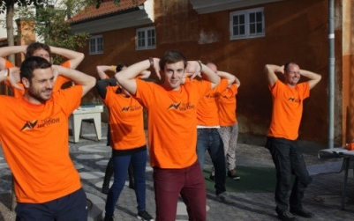
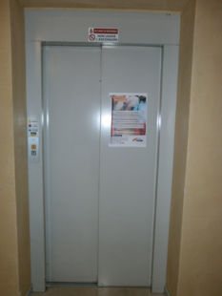
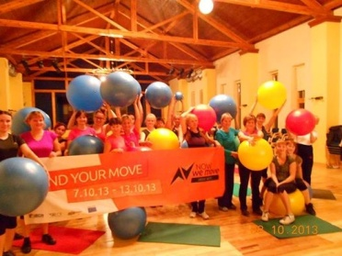
INSPIRATION
Small event - no budget
OFFICE WORKOUT
WHO: ISCA (International Sport and Culture Association)
WHAT: ”10-10-10” - an event organised for ISCA and DGI staff to take part in a 10-minute session of physical activity and show 10 of their best dance moves
NATIONAL ACTION
WHO: ANCI – Associazione Nazionale ComuniItaliani (National Association of Italian Municipalities)
WHAT: Closed down all elevators in public offices and invited workers and the public to use the stairs.
OPEN DOOR EVENT - ACTIVATION
WHO: Terviseklubi Ingel - local sports club in Estonia
WHAT: A chance for ladies on a small island called Hiiumaa to test a new, trendy fit-ball training

Slide 7
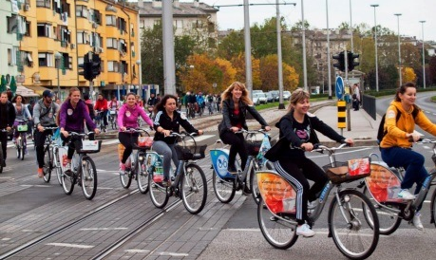
INSPIRATION
Planning - Time management
Nenad Borkovic
Email
MOVE Week 2013 Croatia - Croatia
Organised by:
DRITE – Association of Kinesiology Students in Scholarly Work
The Institute of Public Health Country of Međimurje
Association for sport recreation city of Zagreb, Sport for all
Budget: € 900
Participants: 5500 participants, 110 volunteers
WHAT
Taking the role as MOVE Week coordinator for
Croatia
The recommended time to plan a successful event is
relative and it depends on:
the size of the event (by numbers of participants,
volunteers, partners)
the promotion of the event
the type of the event
if it is a one-day or several days event
if it is one event or more of them
if it is a simple or complicated one
If it has one aspect (only the physical activity)
If it has more than one aspect (e.g. opening ceremony, the main event, closing ceremony)
A planning schedule is very important to have. It may not be implemented 100% but it tells you in the very beginning will there be is a logical possibility to realise what you plan to do. In order to organise everything, we found Tools for MOVE Agents on the NowWeMove official webpage very helpful.
If you just try to implement what they say, there shouldn’t be many problems for you.
HOW
Function as the guide for other MOVE Agents.
Coordinate time schedule, public relations, event promotion.
OUTCOME
96 events, 12 cities, 5503 participants, 44 cross sector partners
Tip from one MOVE Agent to another:
The best lesson I have learned is to be aware that people are the most important in such projects. Take care of people around you, put them first in the plan and let them know you appreciate them.
Quote from Elina Baltatzi: “Ask not what your team can do for you – but what you can do for your team”.

Slide 8
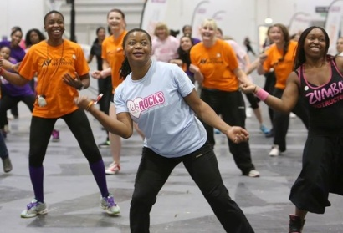
INSPIRATION
Special Target group event
Cath Watts
Email Website
Facebook YouTube
The Us Girls Rocks London Festival- England
Organised by: StreetGames
Budget: € 6.000
Participants: 300 participants / 26 volunteers
WHAT
One-day festival only for women +14.
HOW
Physical activity promotion delivered with beauty incentives for ladies.
The event designed only for young ladies
The Us Girls Rocks London Festival offered an opportunity for young women and girls to try out several different traditional and non-traditional sports and activities, like tennis, table tennis, netball, basketball, rounders, fencing, badminton, box fit, dance and aerobics.
As a reward for trying out different sports there were free hair and beauty treatments on offer such as manicures, massages, eyebrow waxing and hair curling/straightening.
There were also information-sharing stands around the venue covering a range of topics such as sexual health, healthy eating, the implications of alcohol, smoking, and general healthy lifestyle tips with Us Girls organisers and leaders on hand to offer further and personal advice.
OUTCOME
This female only event created a friendly and relaxed atmosphere where ladies had fun and enjoyed sport and physical activity in a safe environment.
Tip from one MOVE Agent to another:
Advertise the day as an opportunity for women and girls to dedicate some time to themselves. Tell people up front if it’s a female only environment or if there are going to be male staff members there. Include challenges or fun competitions to encourage participation. Consider the venue and environment that the event will be delivered in. The venue should make the ladies feel comfortable to join in.

Slide 9
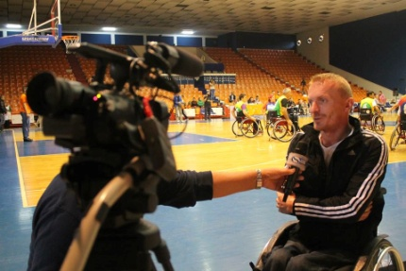
INSPIRATION
Special Target group
Violeta Prenga
Email Facebook
WHEELCHAIR BASKETBALL TOURNAMENT- ALBANIA
Organised by: Active Disabled People Albania-ADP Albania
Budget: € 6.500
Participants: 40 disabled people and more than 10.000 people were reached through television broadcasting
WHAT
Promotion of sport and physical activity for disabled people in Albania through a wheelchair basketball tournament.
HOW
The basketball tournament was organised by participants and a group of volunteers.
Albania is a country where physical activity for disabled people is unknown. The wheelchair basketball tournament helped to promote sport and physical activity for disabled people in Albania. This tournament was a foundation for a better future for people with disabilities in Albania.
The tournament’s goal was not to find a winner, but to exchange experiences through sport and the promotion of physical activity. Teams were put together and matches organised by participants with the help of group of volunteers. This cooperation helped to create a unique network which brought disabled people to the fore in the society around them.
This event was a message, which helped to open Albanians’ eyes to the links between sport, physical activity and disabled people.
OUTCOME
With this event more than 10.000 people were adressed with the message that physical activity should be part of everybody’s lives, including disabled people.
Tips from one MOVE Agent to another:
1) Use the NowWeMOVE campaign to give special target groups (abused women, prisoners; single mothers; Roma children, minorities) a chance to engage with a wider range of people and opportunities to reach a brighter future.
2) Be part of the synergy which happens when working with special target groups – it might happen that the participants consider the event as their own so they want to help as much as possible to make it the best one!

Slide 10
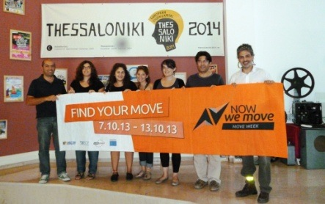
INSPIRATION
Create Cross-sector partner collaboration
Georgios Farfaras
Email Website
Youtube
MOVE AGAINST CANCER- GREECE
Organised by: Ecological Movement of Thessaloniki
Budget: € 200
Participants: 1.000 participants, 30 volunteers
A different relay race was held in Thessaloniki. Skating, dancing, on a wheelchair or with a dog, cycling or just walking, people of all ages and colors, some of them under the stigma of a disease like cancer or HIV, moved for a healthy way of living. The winners were all the participants with their message “Move Against Cancer”.
Stakeholders with different backgrounds came together and highlighted the movement against cancer. Booths from 14 different project partners informed the public and participants about the European Code Against Cancer and the benefits of everyday physical activity, promoting walking, cycling and skating for sustainable mobility and activities like dancing as being accessible to all citizens in a safe environment.
WHAT
Move Against Cancer - Promotion of healthy lifestyles, physical activity and awareness of cancer.
HOW
The event was held thanks to a voluntary cooperation between different stakeholders.
Project partners:
“Disability Today "
"ANTIGONE-Information and Documentation Centre for Racism, Ecology, Peace and Non Violence"
"Union for the rights of pedestrians"
"Positive Voice"
"Kinesthesia"
"Kids in Action"
"Greenways Social Cooperative"
Association of Disabled "Merimna Zois"
Association of Parents 1st Special School
Association of Parents of 5th Special Education Schools
Association of Women with Breast Cancer "Alma Zois" Prefecture of Thessaloniki
"Beauty Against Cancer"
"Thessaloniki's Rollers Skaters"
OUTCOME
The stakeholders made a decision to organise the event "Move Against Cancer" on annual basis every year.
Tips from one MOVE Agent to another
1) Organise common meetings to share information about the events;
give time to stakeholders to meet and exchange ideas.
2) Give the possibility for different messages to be disseminated on the event day and incorporated in the communication before and after the event.

Slide 11
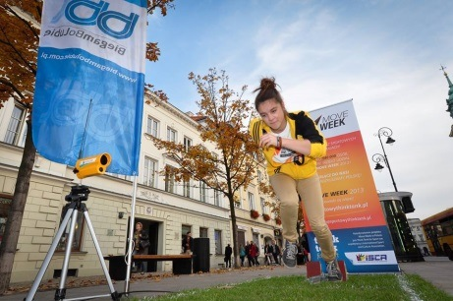
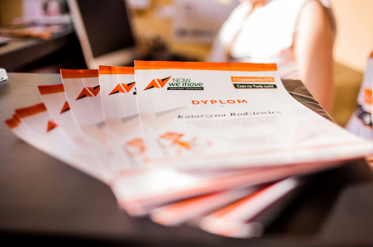
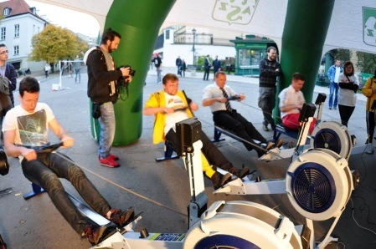
INSPIRATION
National event organisation
MOVE Week Poland – Special contest
Agnieszka Garbacik
Local Coordinator in Poland
Email
Country: Poland
Organisation: Volunteers4Sport Foundation
WHAT
MOVE Week Poland 2013 was based on the idea of involving sports animators as MOVE Agents, mostly those working on the mini pitches – Orliki (multifunction sports grounds). The process started with a special contest, the winners of which were awarded with a starting package that helped them to organise MOVE Week in a given location. As a result of the contest 60 MOVE Agents were chosen. They took part in a two-day seminar on MOVE Week.
Additional benefits for the MOVE Agents:
Tracksuit, the animator's kit, advertising/visual materials.
Additional benefits for the MOVE Week participants:
MOVE Week gadgets.
HOW
We started our MOVE Week 2013 preparations in the middle of July. We created special website www.tydzienruchu.pl and Fan Page and decided to have communication strategy based on contest. Our promotional tools included emails, Facebook campaign, and articles.
Our budget: 50 000 euro from Ministry of Sport and Tourism. We also received a financial contribution from ISCA. In addition, we cooperated with companies who gave us attractive awards for the participants.
OUTCOME
68 local events, 3 flagship events, 58 Cooper Tests, 25.000 participants, 600 volunteers

Slide 12
INSPIRATION
Activation events
National - International
WHO: Pro Velo Switzerland
WHAT: Bike to work! Promote the bicycle as transport to go to work. The one who cycles for the most km. wins a prize.
LOCAL EVENT
WHO: Municipality Veldhoven
WHAT: After school sports project. Kids can follow different kinds of sports lessons after school. Organised by local sports clubs
National - local
WHO: DTB (Deutscher Turner Bund)
WHAT: LaGYM Party
Feel the rhythm, have fun, just enjoy and dance the night away. A new fitness program focused on endurance, flexibility and coordination.

Slide 13
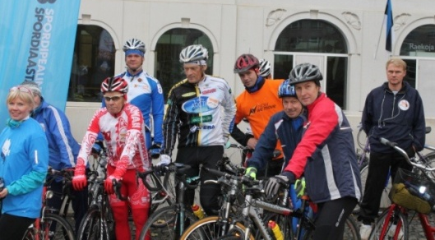
INSPIRATION
Community event
Pille Muni
Email Website
Facebook
MOVE WEEK IN SPORT CAPITAL OF ESTONIA
Organised by: Sport Year Foundation
Budget: € 700
Participants: 1500 participants, 50 volunteers
WHAT
Different events in one county through out one week.
In 2013, Ida- Virumaa was the first Estonian county to be called the Estonian National Sport Capital. The aim of this honorary title is to spread sport activism and active lifestyles around Estonia, to develop sports and sport for all in one certain region in Estonia within one year,
to highlight this region and to make people see it in a positive light.
Sport Year Foundation took the initiative and promoted MOVE Week in one county, Ida- Virumaa, by engaging different local institutions and stakeholders:
Politicians- helped to share the message and attended the events
Sport leaders, ambassadors- shared the message
Sport activists, volunteers- helped to organise events
Local sport and recreational centers- provided facilities
Enterpreneurs- supported through sponsorship
Community PR- shared the message through official channels
Kindergartens, schools- organised events
HOW
One organisation which co-worked with different stakeholders in its county.
OUTCOME
The county’s sport environment got a positive boost from local stakeholders who highlighted sport for all topics.
Tips from one MOVE Agent to another:
1) Approach communities by offering them help to resolve their current issues, e.g. if there is a problem with integration, offer them a chance to cooperate in organising an event for cultural learning through physical activity.
2) When there are elections coming, use the chance to approach politicians more easily by offering them opportunity to “shine” at local events.

Slide 14
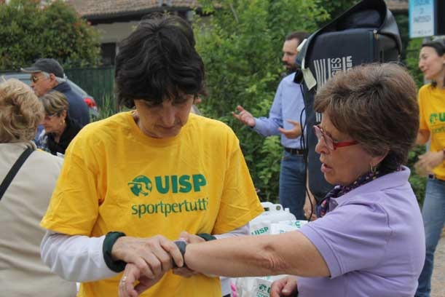
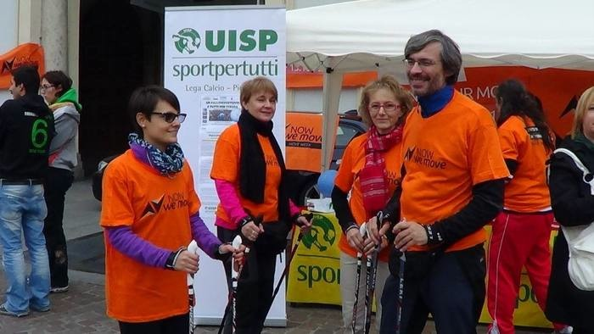
INSPIRATION
Collaboration between municipalities
Paola Paltretti
Website YouTube
UN KM IN SALUTE – ITALY
Organised by: UISP Sportpertutti
WHAT
Un km in Salute ‘A healthy kilometer’, an event aimed at promotion physical activity.
HOW
Through collaboration between healthcare companies, provincial committees and municipalities.
People can choose a fast walk or slow run in the park. It is a 1km route through a park, in which participants are timed every 100m in order to determine the ideal speed to exercise without over or under working. The overall goal of the project is to allow people to form groups of similar physical abilities, so that they can join in together and continue their activity throughout the year with individuals who are at the same level as them. The project aims to promote healthy lifestyles among average citizens as well as opening up the cities’ natural spaces to all members of the community, including those who live a sedentary lifestyle.
The main goal of this project is to increase the number of Italians who are physically active, and engage them in physical activity both as a means of community building and in order to improve their fitness levels. The objective is to give people a push to begin exercising, without leaving them feeling intimidated or overwhelmed.
Collaboration between Regionale Emilia-Romagna, Regionale Marche, Centro Nationale per il Controllo e la Prevenzione delle Malattie (CCM), Italian sport for all organisation (UISP)
OUTCOME
In 2013 the event took place in Bologna, Parma, Ravenna, Ferrara, Rimini, Forli, Faenza, Lugo, Reggio Emilia, Cesena, Pesaro and Taranto.

Slide 15
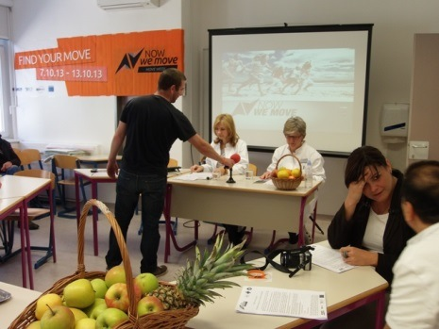
INSPIRATION
Cross sector collaboration – Health and Physical activity
Renata Kutnjak
Website Facebook
MOVE WEEK CROATIA 2013 IN MEĐIMURJE COUNTY - CROATIA
Organised by: The Institute of Public Health of Međimurje County
Participants: 2.803
WHAT
MOVE Week Croatia 2013 in Međimurje County included a number of activities coordinated by the Institute of Public Health County of Međimurje.
HOW
By creating cross-sector partnerships we managed to encourage cities and municipalities, tourist offices, non-governmental organisations, educational institutions, sports associations and a retirement home to participate in the celebration of the European MOVE Week.
The Institute of Public Health of Međimurje County acted as the coordinator of all activities. The leading institution in the country when it comes to health promotion and disease prevention as well as control of communicable and non-communicable chronic diseases, with a network of partnerships with other local, national, and international health and social professionals and institutions, NGOs, schools, media and local governments.
All partners organised their activities at their own cost. Some activities that had been organised as part of other programmes were fitted in the MOVE Week, while others were created anew.
We gathered such a big number of partners by contacting them via email .The partners whodecided to join in were then contacted again several times via email before they were invited to a meeting. The first meeting was organised before the beginning of the campaign (followed by a press conference), and the second after the end of all activities in order to exchange experiences and discuss the prospect of cooperation the following year. It was there that we agreed to hold the first meeting this year no later than the beginning of May 2014.
OUTCOME
19 partnerships, together they organise 34 different sporting and recreational events for people of all ages, with over 2.800 participants and 48 different media publications.
Tip from one MOVE Agent to another:
Use your own network. Contact them and make concrete plans in a meeting.

Slide 16
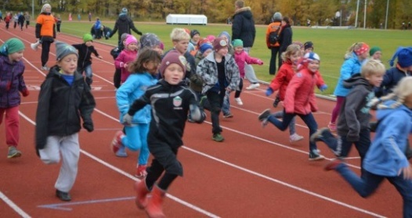
INSPIRATION
Partnership – Involve the whole community to activate citizens
Gunner Gunnarsson
Email Email office
MOVE WEEK FLJÓTSDALSHÉRAÐ – ICELAND
Organised by: Fljótsdalshérað and Höttur, supported by UÍA
Budget: € 2000 (mostly spent on PR materials)
Participants: 1.700 people of all ages over a number of days
WHAT
UÍA focused on helping non-movers find their MOVE by creating diverse activities
HOW
Bringing together all kind of organisations from the community, from the local sports clubs to the local supermarket.
UÍA focus on helping non-movers find their MOVE by making diverse activities available. Their work brings together partners to offer a range of events in the municipality during MOVE Week. The common branding of MOVE Week for all the events will be used to spread the message community wide and create media attention.
We had our first meeting in February/March with UMFÍ. We kept in touch via e-mail and met 1-2 times over the next months. The organisation began for real in late August/early September. The municipality and the sports club divided the corporations, institutions and sports leaders between them. They began with e-mail, then followed up with phone calls and personal visits. We had people joining in until the last minute.
OUTCOME
35 + open activities mostly with the Höttur sports club. Aroubnd 100 people were responsible for overseeing the events.
Tip from one MOVE Agent to another:
We have the luxury of being just 4.000 in all (+2.000 in the town) and therefore the communication channels are very short. The sports club is highly involved in the daily life of the inhabitants, therefore it is a reconised and valued brand. The formal involvement of the municipality increased our credability.
The best advice we can give is to enourage people to form personal relationships. Don‘t hesitate to contact shop owners, managers etc. The worst thing you can get is a ‘no’. Also explain why they should be involved. Do they get extra business? How will the participation increase their image? (in our case we used the opportunity to bolster the image of the municipality).

Slide 17
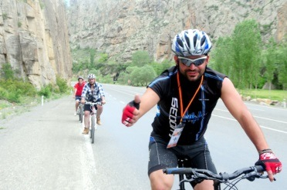
INSPIRATION
Promotion of cycling tourism and infrastructure
Adnan Cangir
Email Video
“LIFE WITH CYCLING IN CHORUH VALLEY” – TURKEY
Organised by: Caglayan Science, Culture and Art Association
Budget: € 1.000
Participants: 100 people on bikes and hundreds of passers by
WHAT
Open door local cycling event to promote the Choruh Valley in the north-eastern region of Turkey.
HOW
Connecting the bicycle city ride with a big local event which attracted many other locals and guests visiting the city.
The event was about creating awareness that cycling has got a lot to offer cities in terms of better standards of living. We, along with the municipality of Bodrum, organised a rock concert performed by a local rock group which attracted hundreds of people at the main square in the city centre. Following the concert we organised a city ride which attracted many other locals and guests visiting the city.
The most important achievement with this event is that there had been a very small group of cyclists in the town who had not been able to get organised until this event. This event has sparked a fire and now the community is growing to become a registered association. No one can stop them now. They organise weekend tours, instructional sessions, etc.
The Municipality of Bodrum, as partner, prepared posters for billboards, announced a press release and invited locals through the live announcement sound system right before the day and during the day of the event. The news was spread around the media and took place on TRT (Turkish national TV) .
OUTCOME
About 20 volunteers including 6 ENVERCEVKO members, a rock band and the other municipality staff. About 100 cyclists as participants.
Tip from one MOVE Agent to another:
Be enthusiastic and pass your energy on to others.

Slide 18
INSPIRATION
World Heart Day Joining forces with MOVE Week - to create better heart-healthy choices wherever you live, work and play
Rachel Shaw
Rachel.Shaw@worldheart.org
World Heart Day 2014 - 29th September
Organised by: World Heart Federation
Participants: Global
WHAT
CVD is the world’s number one killer. It’s already responsible for 17.3 million premature deaths, and by 2030 this is expected to rise to 23 million. However, most CVD can be prevented by addressing risk factors like tobacco use, unhealthy diet and lack of physical exercise.
This year MOVE Week begins on World Heart Day, the 29th September, making it an ideal time for us to join forces to promote our message of creating heart-healthy environments where we can all get moving in safety to reduce our risk of developing CVD.
While you're taking part of your MOVE Week activities, please take a moment to share pictures of where you're doing them... show us just how heart-healthy or even unhealthy those environments are.
Here's what you can do...
GET TWEETING
You can tweet your pictures to www.twitter.com/worldheartfed using #heartchoices - don't forget to tell us about your MOVE Week activity too.
You can also show your support for MOVE Week and World Heart Day by tweeting a photo of you and your fellow MOVE Weekers doing the hand-heart selfie! Use the same address and hashtag as above.
SIGN OUR PETITION TODAY!
Join us in calling for better heart-healthy choices wherever we all live, work or play and for taking action to embed the world’s number-one killer in the post-2015 Sustainable Development Goals.
HOW
You can also show your support for MOVE Week and World Heart Day by tweeting a photo of you and your fellow MOVE Weekers doing the hand-heart selfie! Use the same address and hashtag as above.
OUTCOME
Everyone has the right to make heart-healthy choices wherever they live, work and play. But we all need to take action to make it happen in our homes, communities and nations.
Sign up to our global petition and bring the global burden of CVD to the attention of world leaders. GO TO WWW.WORLDHEART.ORG/
.

Slide 19
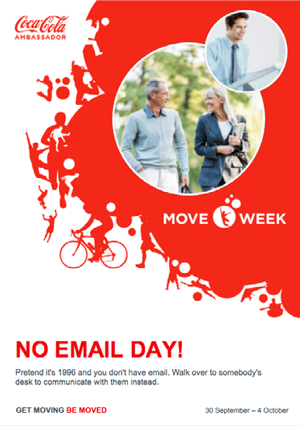
INSPIRATION
Moving the office
MOVE Week Coca-Cola – Toolkit for employers to activate them in the office
Coca-Cola created a toolkit for its employers full of inspiration as to what they could do to be more active in the office.
Our objectives were to:
• Inspire our employees to be healthy and active, at work and outside work, both during MOVE Week and long afterwards
• Work with our existing community or Active Healthy Lifestyle partners to combine engaging community events with physical activities for associates
• Have a week filled with fun and inspiration, with activities and events which reinforce our Refresh 2020 messages and remind us that we are all ambassadors for the Company
MOVE moment
A screensaver with physical activities is implemented on
every employee’s desktop. Every time the screen goes black
a certain suggested activity will pop up.
Fun Run for lunch, Cycle, jog, walk or rollerblade to work
Whole office building goes on a fun run or walks around the nearest local park/gymnasium in lunch hour. Instead of taking the car or public transport, swap for cycling, jogging, walking or rollerblading to work.
Nano activities
Place stickers with micro exercises in offices and workspaces.
TCCC Tai Chi
Instructors come to the office and hold mass classes at every location, simultaneously.
Football, Boules or other tournament
Employees can enter different optional competitions and there is a grand finale at the end of the week. They can invite family and friends at a certain time of the day.
Bikes2Borrow
Borrow a bike for your meeting or on your way home overnight. Or why not extend it to the weekend?

